Slide 1
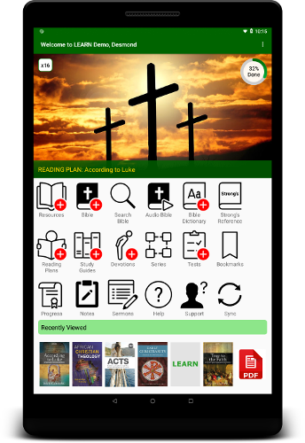


L E A R N Global
LEADERS EQUIPPING AND RESOURCING NETWORK
www.churchleaderslearn.org

Slide 2


“[Many] countries face a number of challenges and the church there lacks the contextual biblical resources to equip pastors and evangelical leaders to shepherd disciples and lead the church.”
Langham Partnership (uk.langham.org)

Slide 3
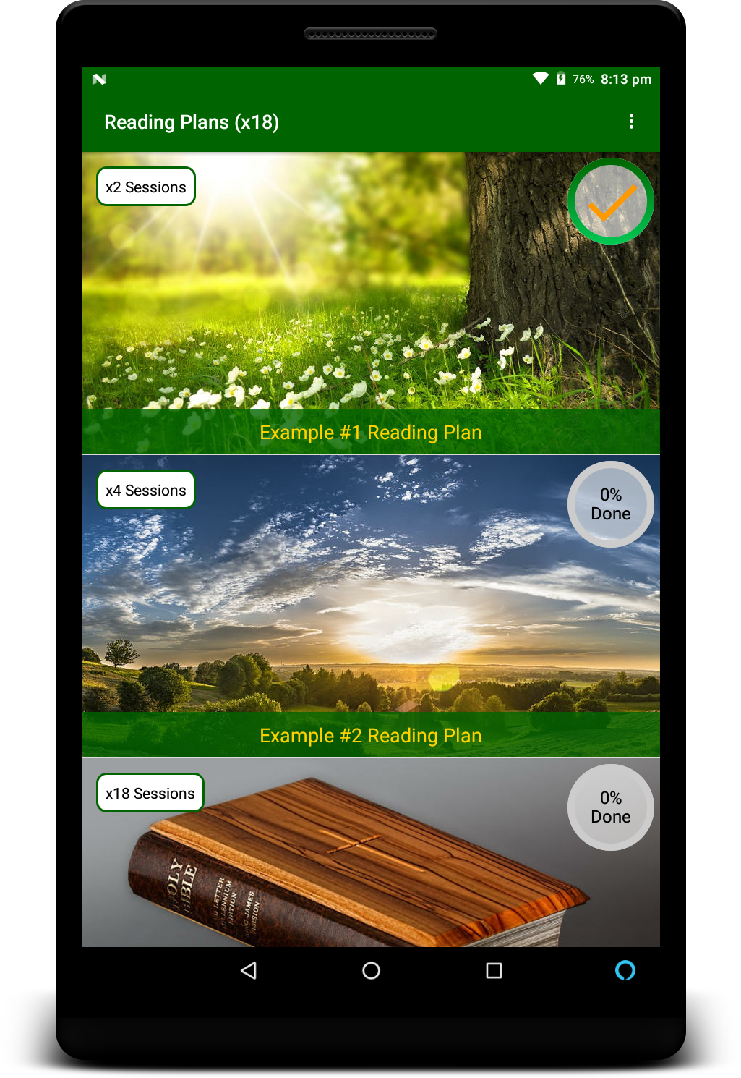







Learn with LEARN
Our Aim
To equip and resource church leaders to be effective communicators of the Gospel

Slide 4

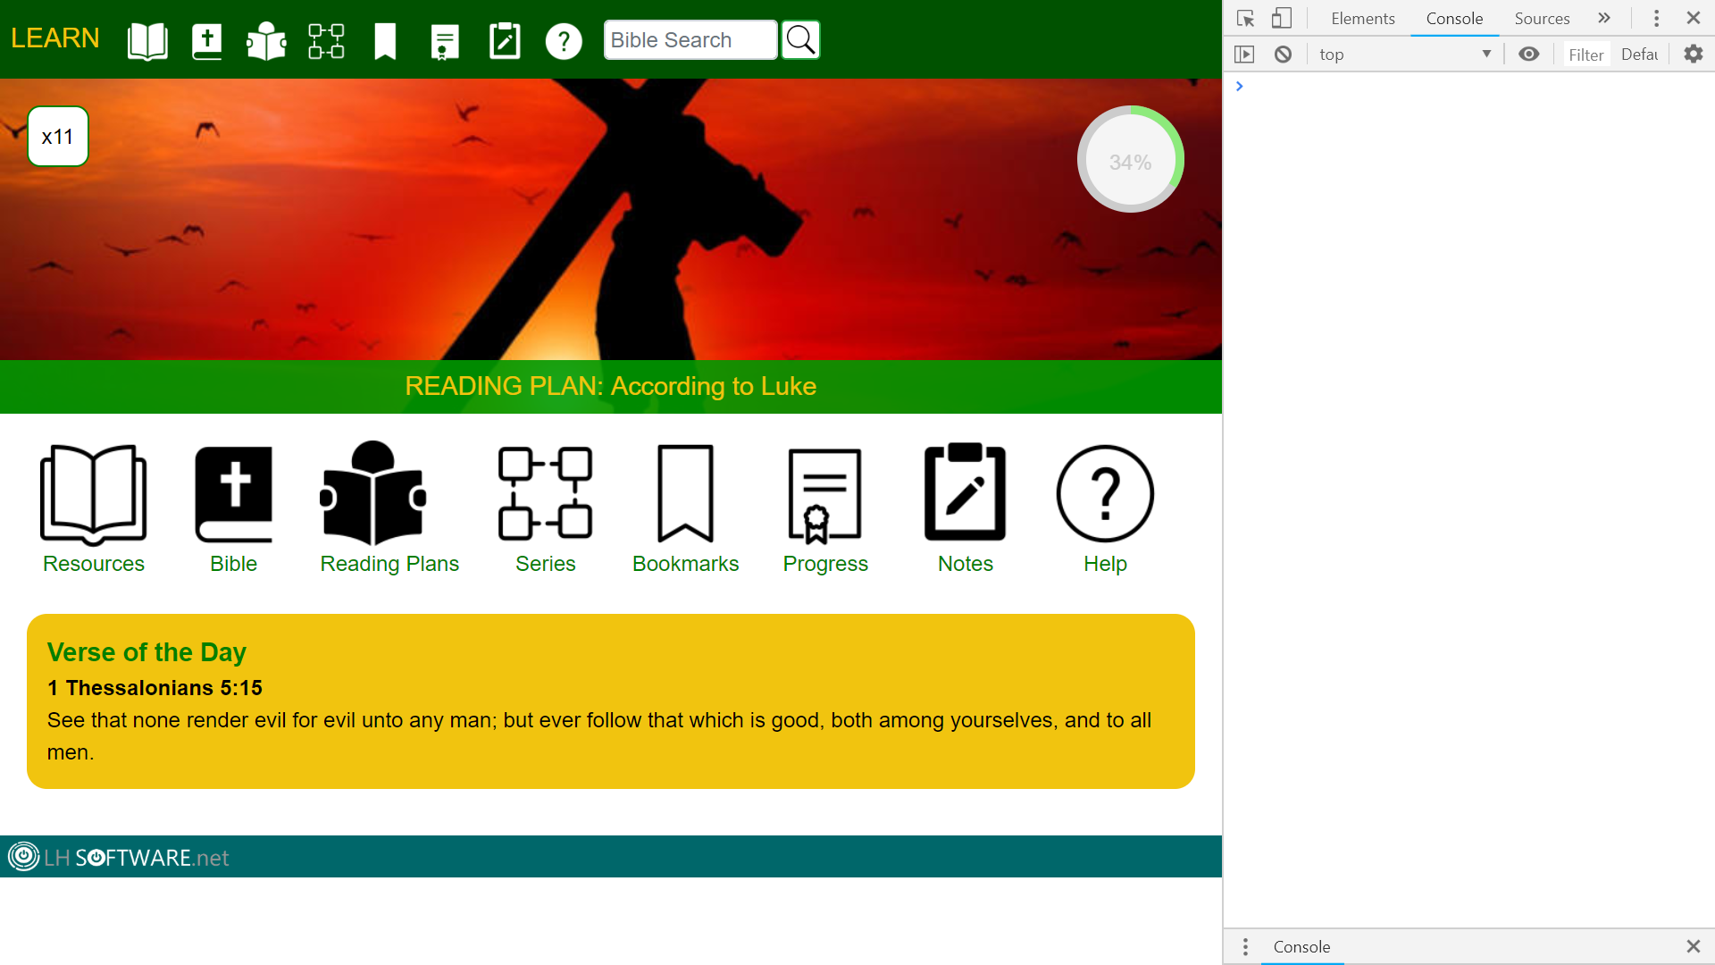
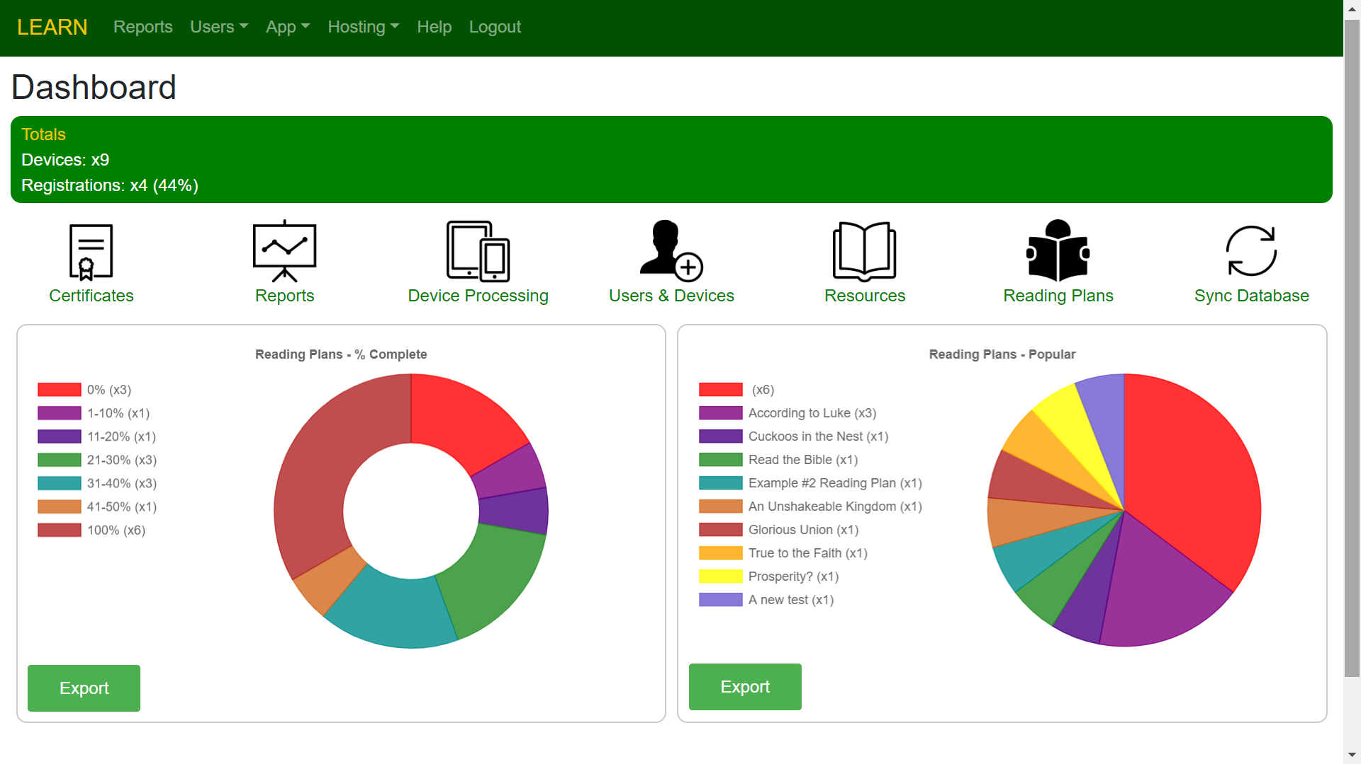


LEARN Network
Android App
Web App
Admin App
Mentor App
The LEARN network allows organizations to add hand-picked content securely in multiple languages.
Users with limited Internet access do not have to be online to use the Android app.

Slide 5
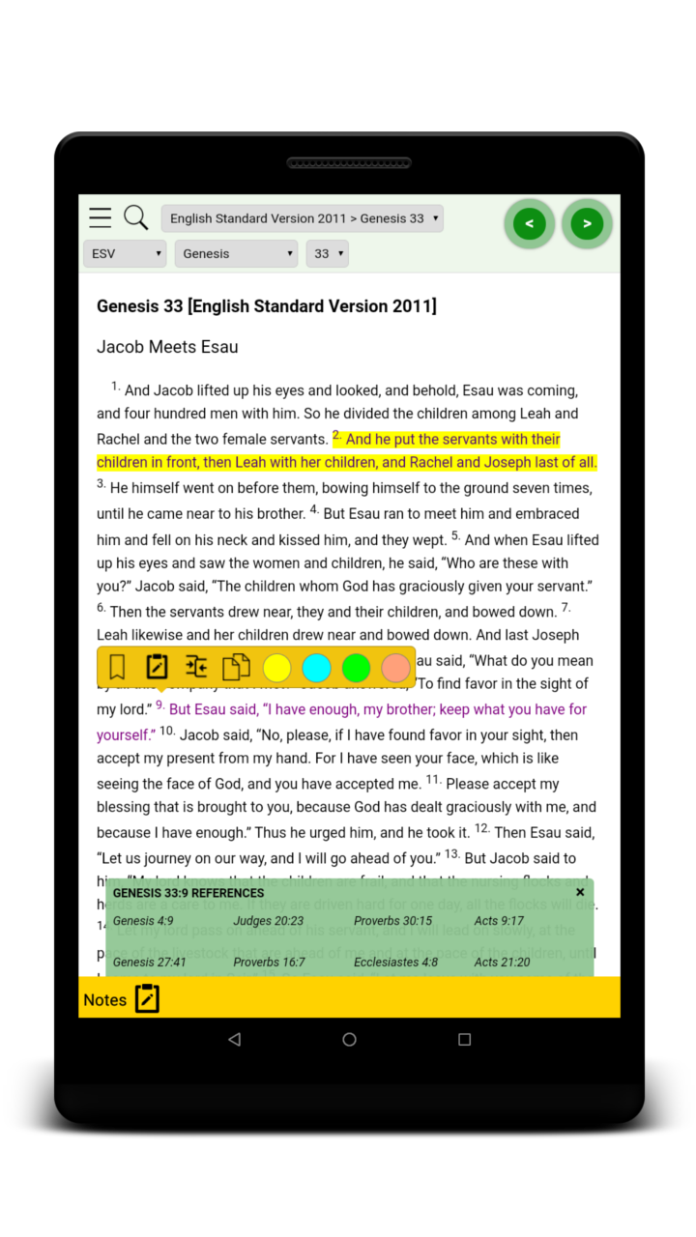
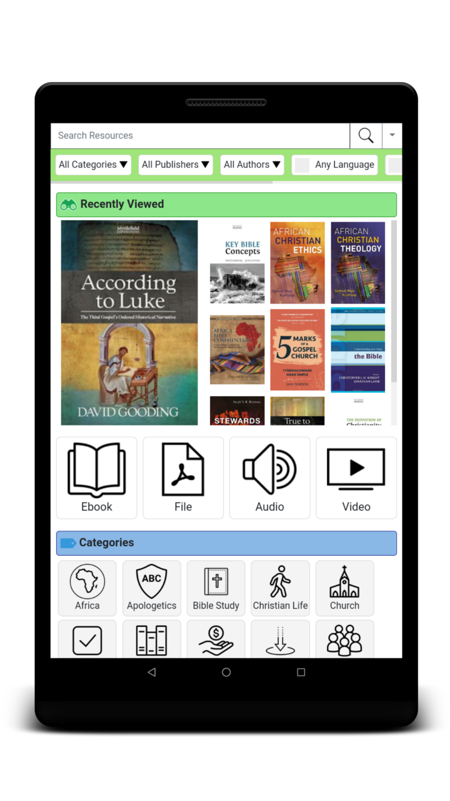
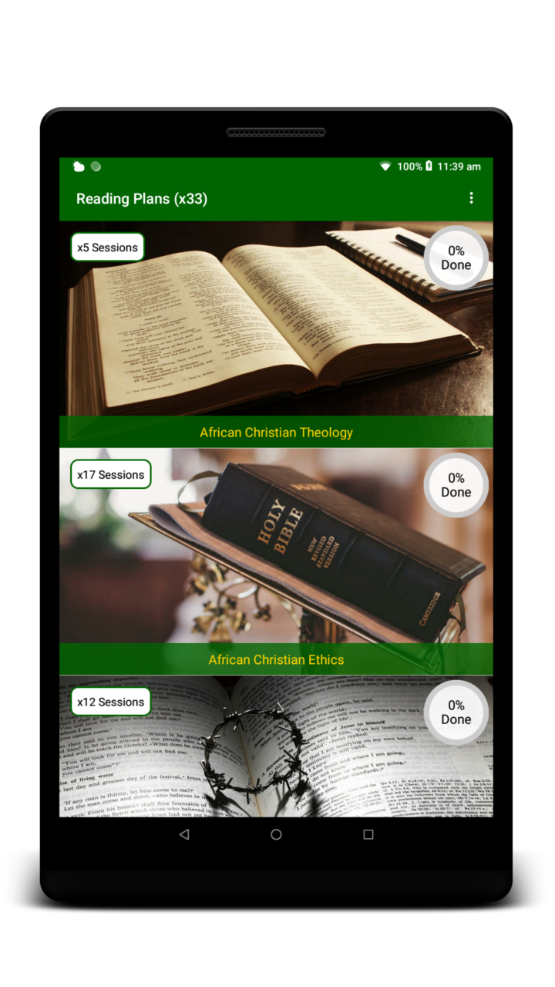
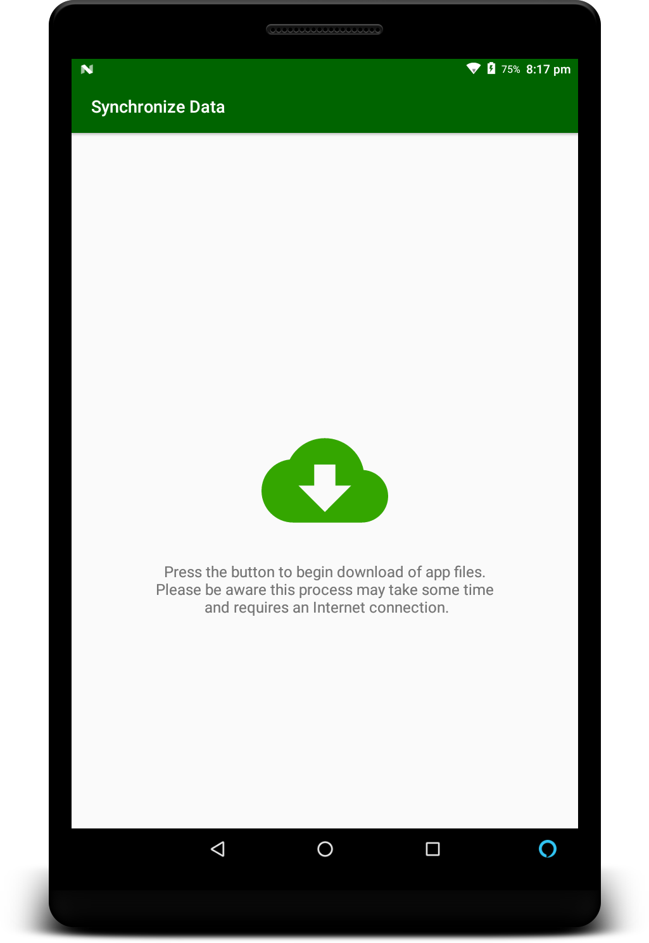
Android App Features
Bible
Resources
Reading Plans
Downloads
Multiple versions
Searchable
Take notes
Bookmark passages
Interactive with ebooks
Ebooks, PDFs, Video, Audio
Fully encrypted
Bookmarks & notes
Ebook reader
Searchable
Customizable reading plans
Session-based learning
Fully trackable
Certificate awards
Progress charts
Download new content
Backup progress
Sync with Web App

Slide 6
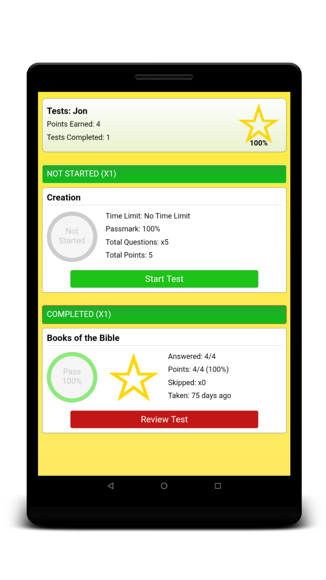
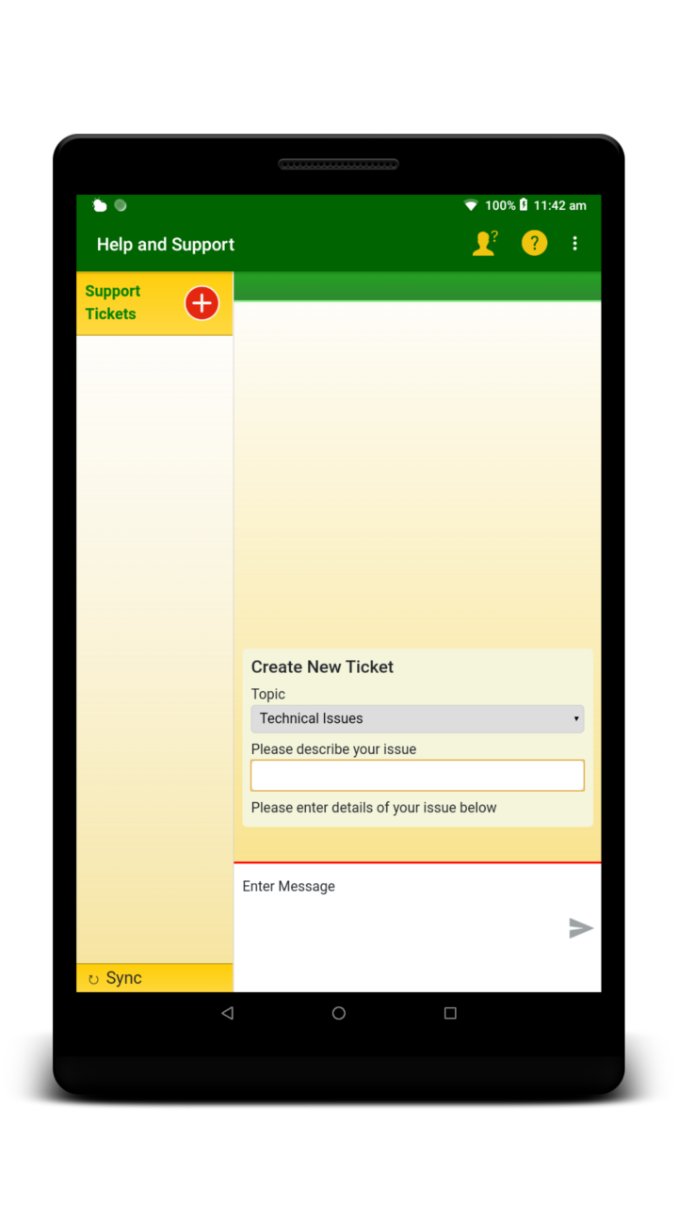
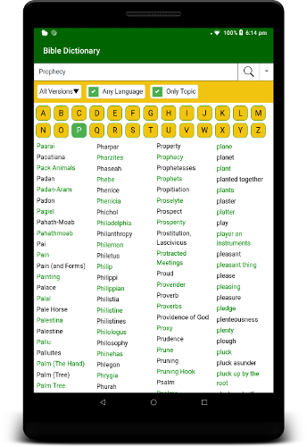
Android App Features
Portal
Tests
Support
Bible Dictionary
Easy access to features
Recently viewed resources
New resources
Verse of the day
Latest news
Multiple choice
Free text
Essay-style
Progress & review
Integrated Help section
Support ticket system
Request support offline
Multiple combined dictionaries
Strong's Concordance
Searchable
Index

Slide 7
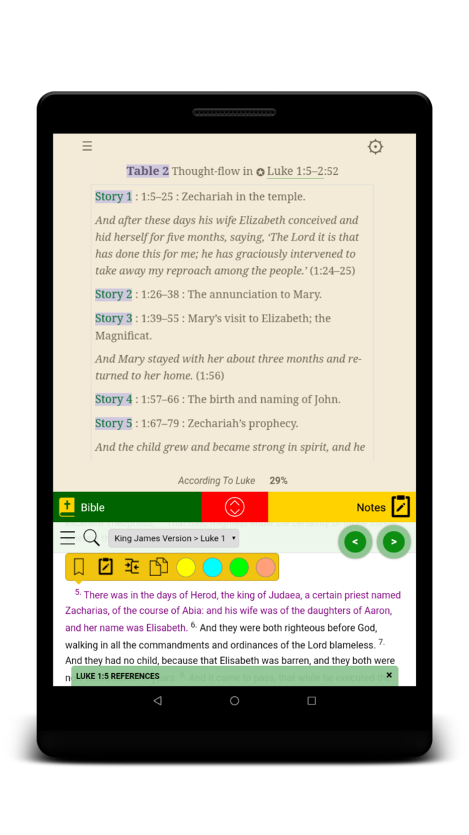
Ebook Reader
Highlight
Text
Bookmark Pages
Interactive Bible
Notes Study Panel
Search Content
Copy/Paste Disabled
Change Background Colour
Enlarge Text Size
Read From Last Page

Slide 8




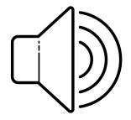
Bible
>
Search the Scriptures
Navigate Easily
Multiple Versions
Copy Content
Cross References & Bible Book Details
Add to Notes
Circa 565BC
Side by Side View
Audio Narration

Slide 9
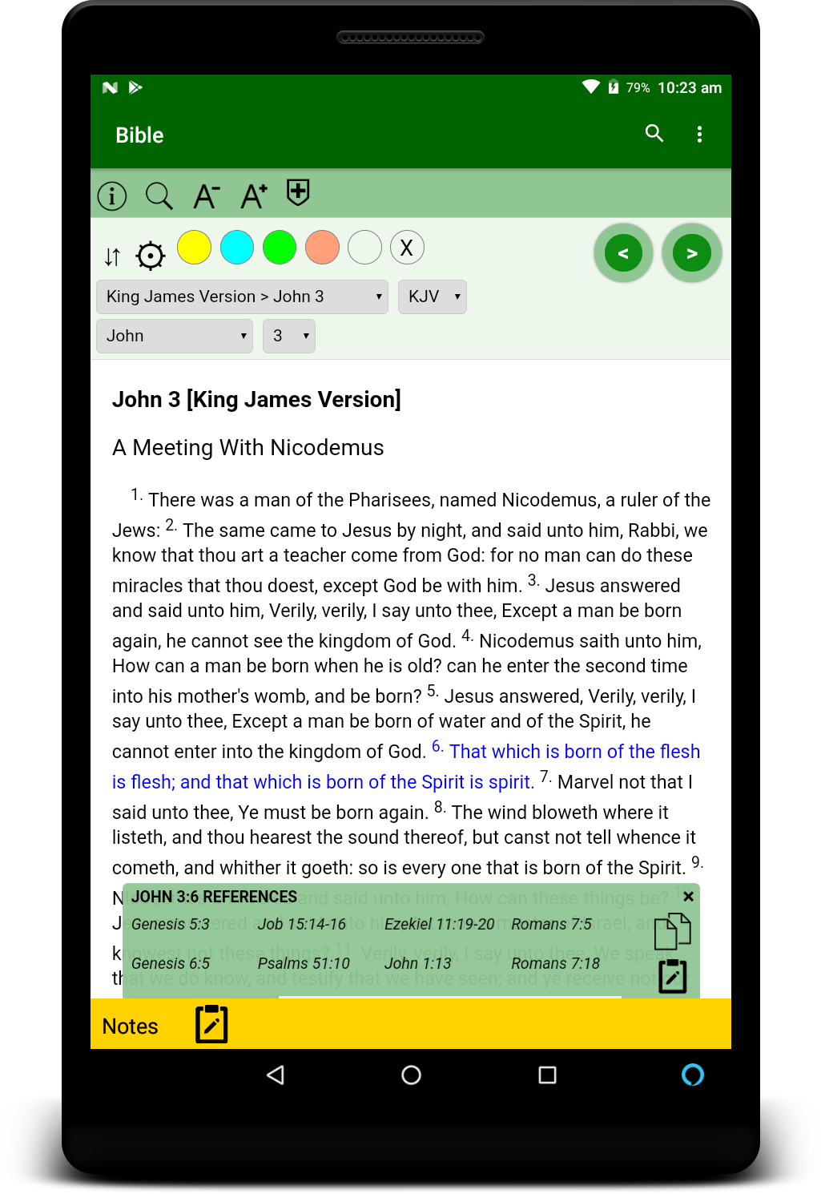
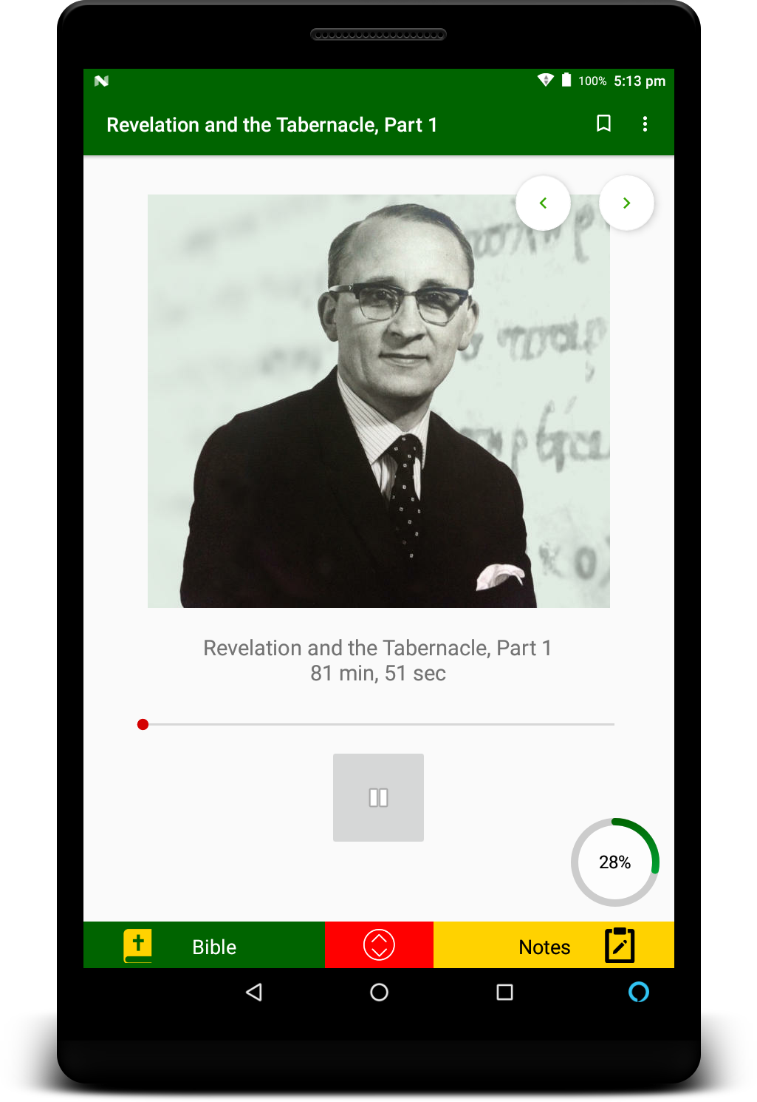
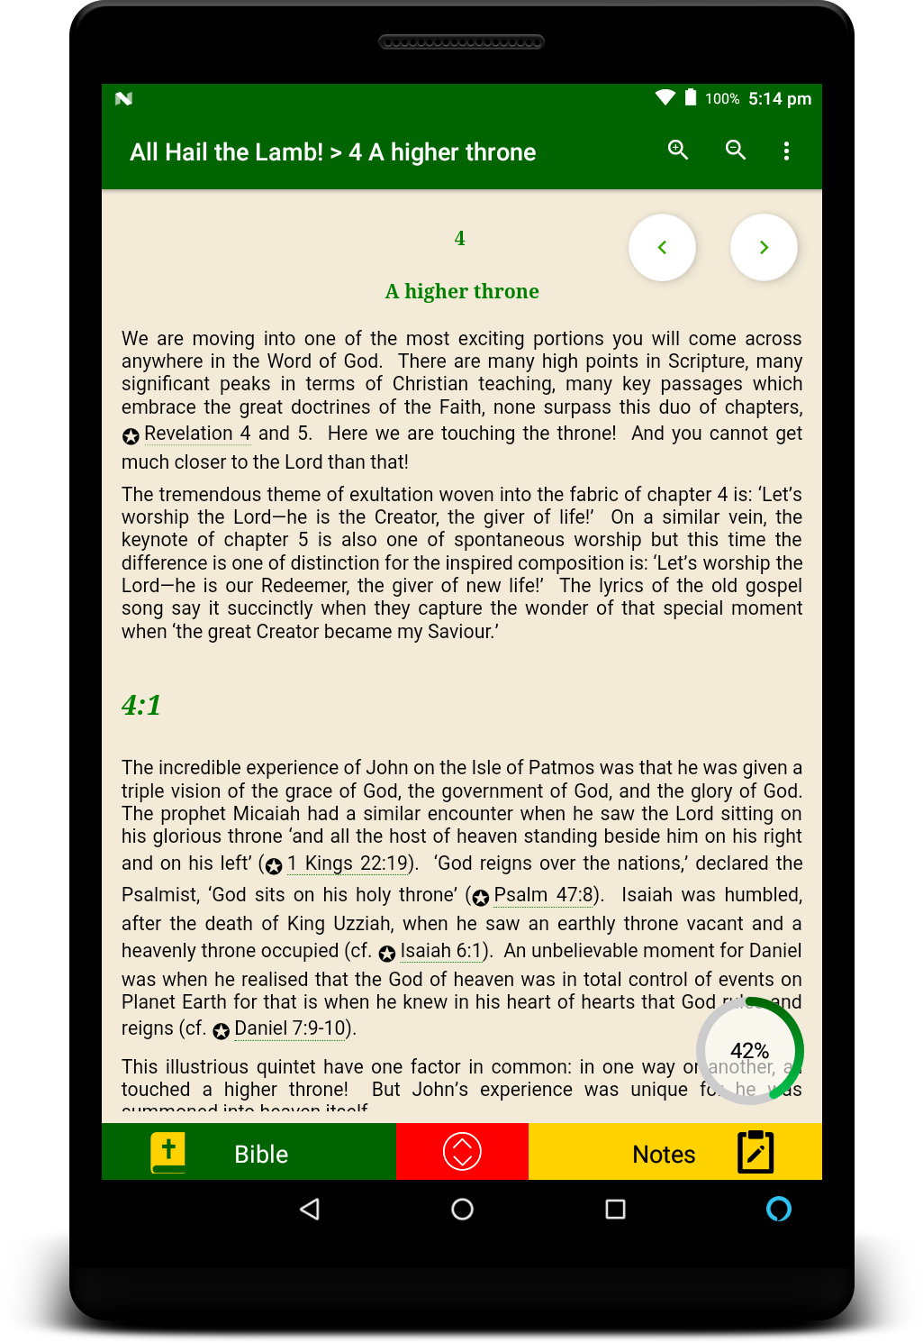
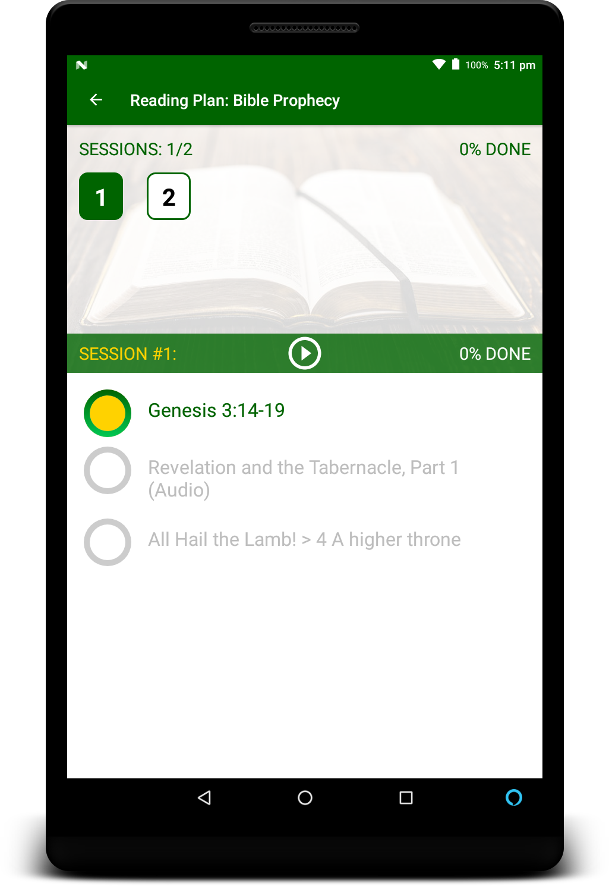
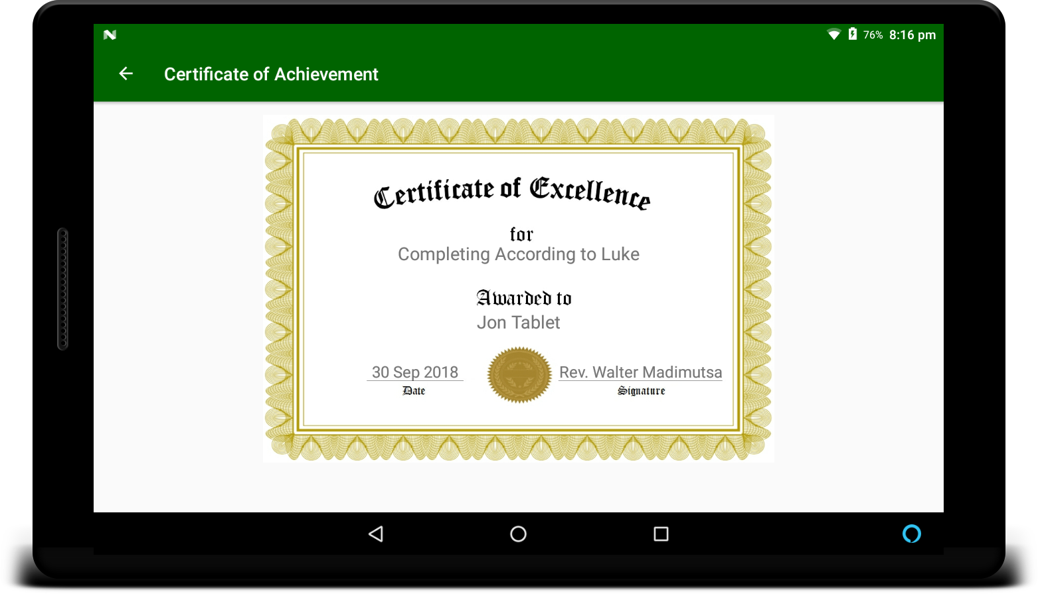
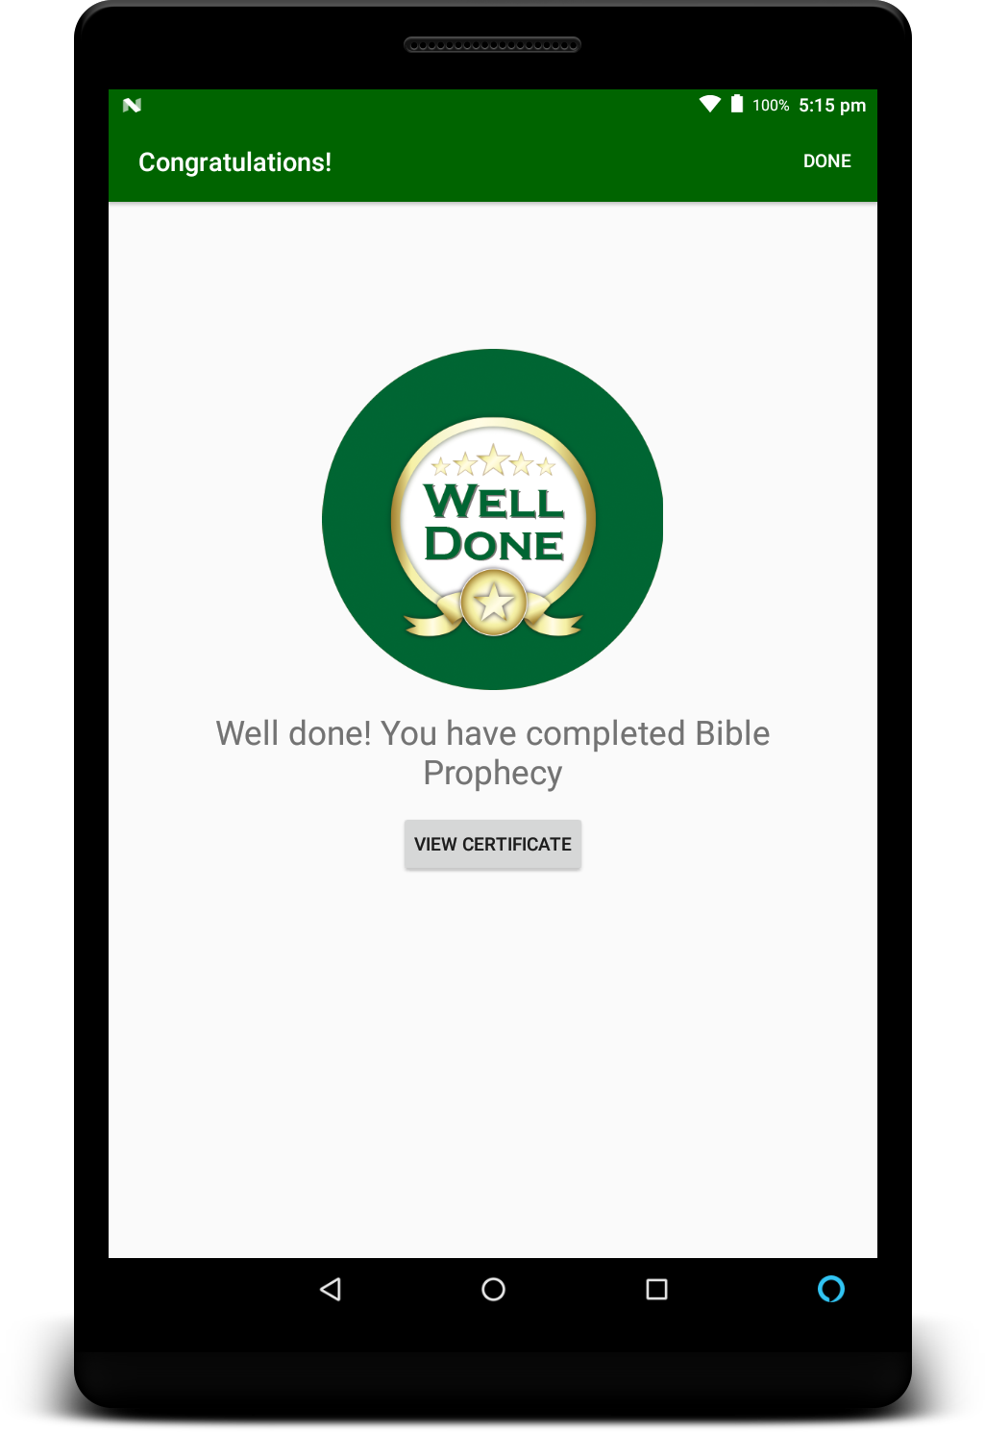
Reading Plans

Slide 10




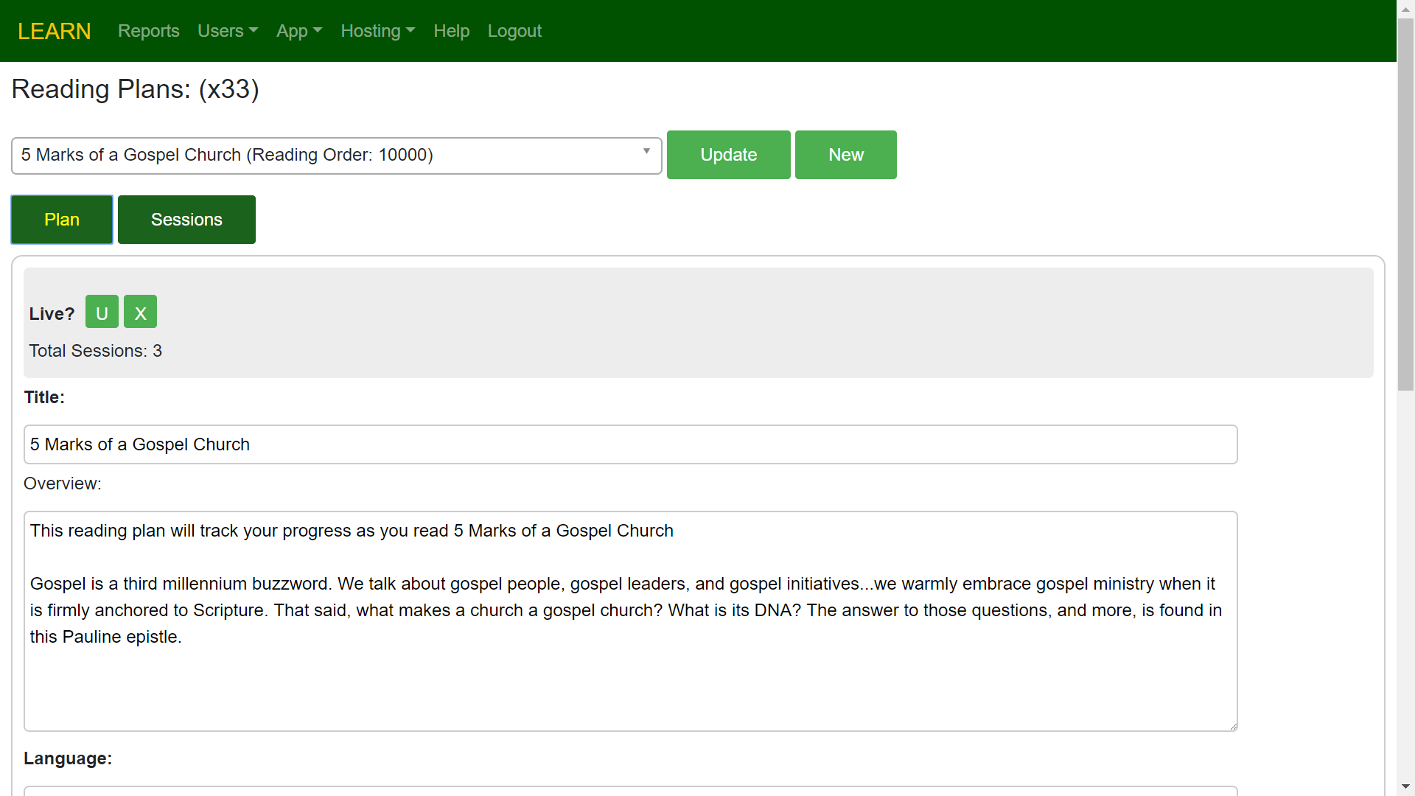
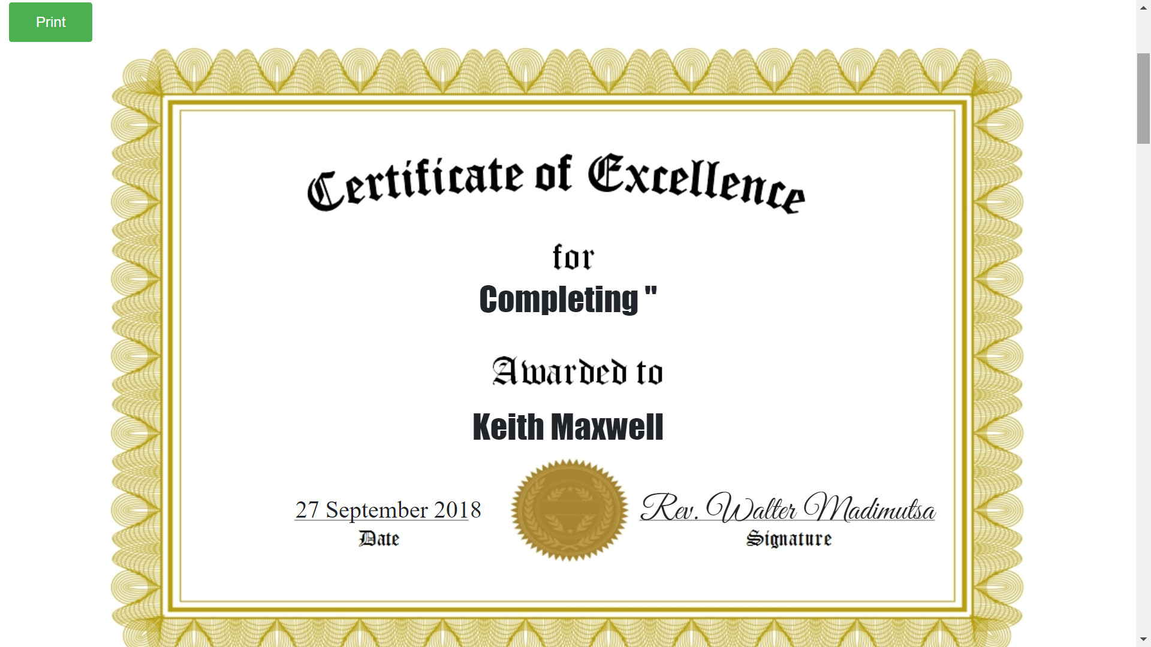




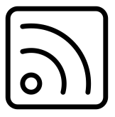
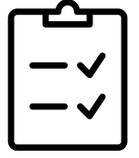
Admin Portal
Reports
Add Resources Securely
Manage Users & Devices
Print
Certificates
Reading Plans & Study Guides
Create Resource Series
App
News
Manage
Tests

Slide 11

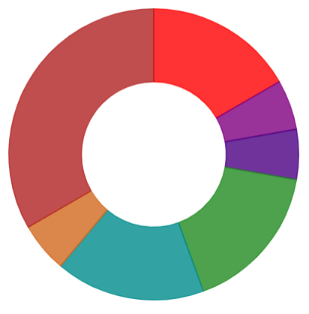

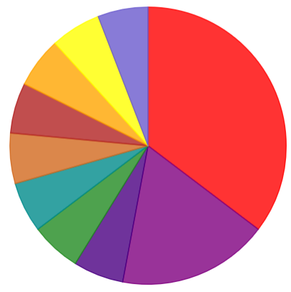
Generate Reports
LEARN records vital user interaction including:
2020
Reading Plans & Study Guides Activity
Resources Interaction
User Information
Device Statistics
Bible Reading Activity
Top Searches
Publisher Data
Test Results
Sermon Data
2019

Slide 12
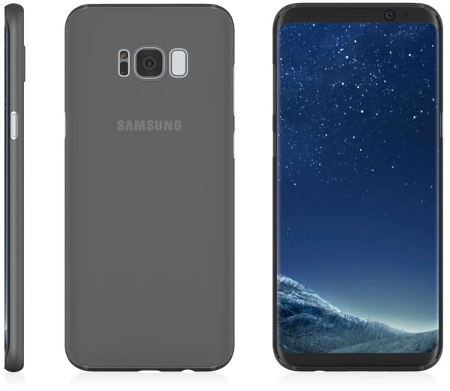
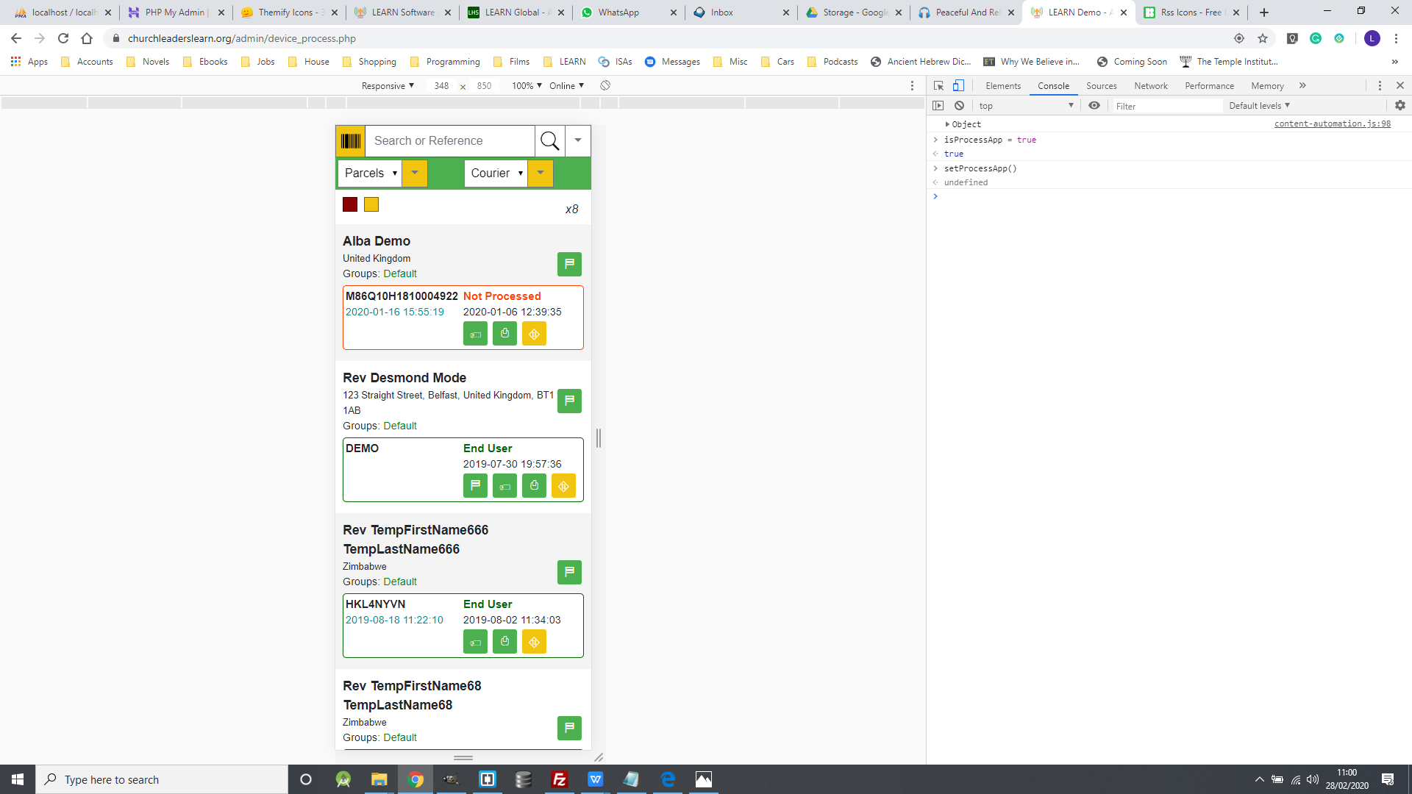

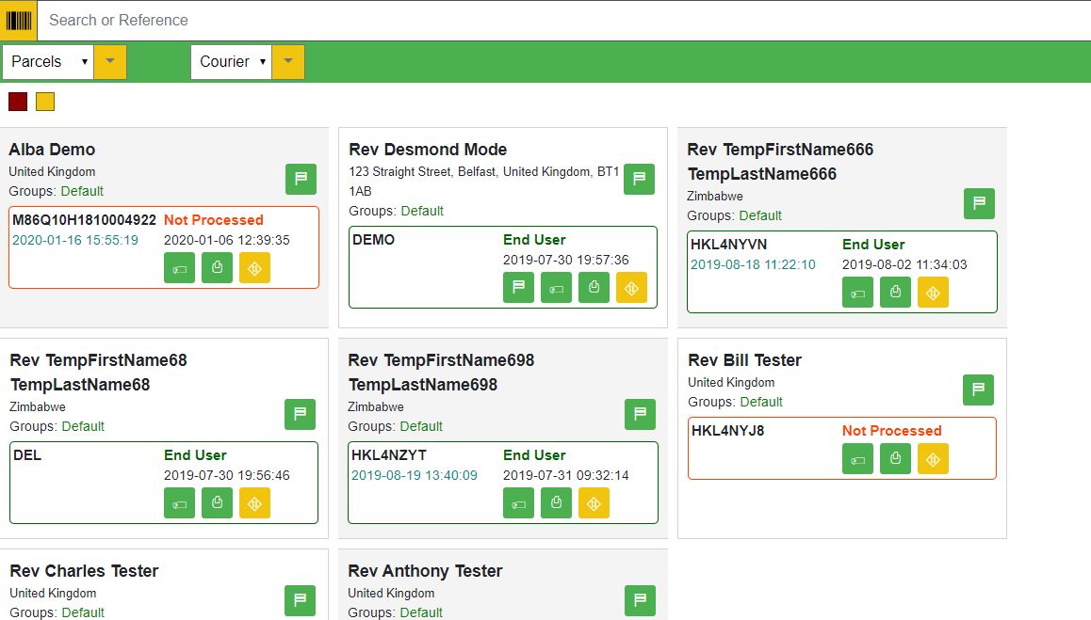
Device Processing App
Process Multiple Devices
Process and register Users and Devices efficiently and effectively
Real-time Reporting
View live device processing and registration in the Admin Portal

Slide 13








Trusted Publishers

Slide 14
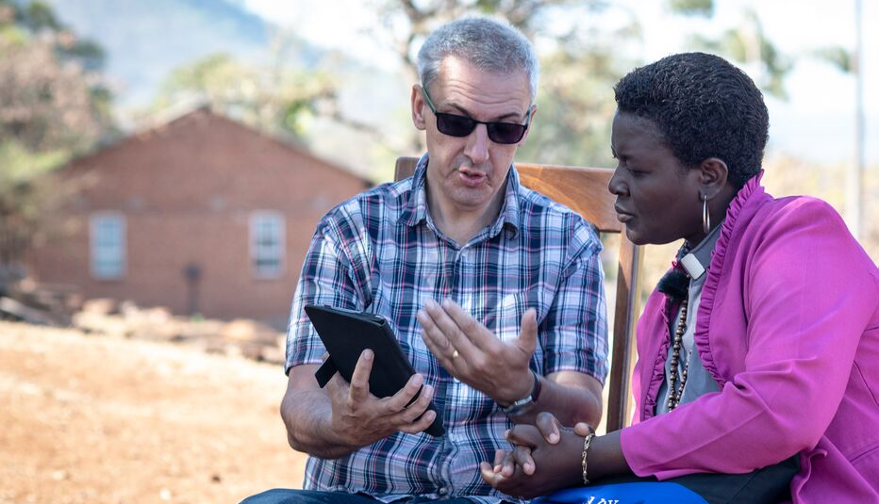

SIM Zimbabwe
x200 Church Leaders since March 2019
50+ Christian Resources
Multiple Bible versions
Bible Narration/Audio in Shona
Country-wide Rollout

Slide 15

Gospel Growth
x1,300
x130,000
x13,000,000

Slide 16
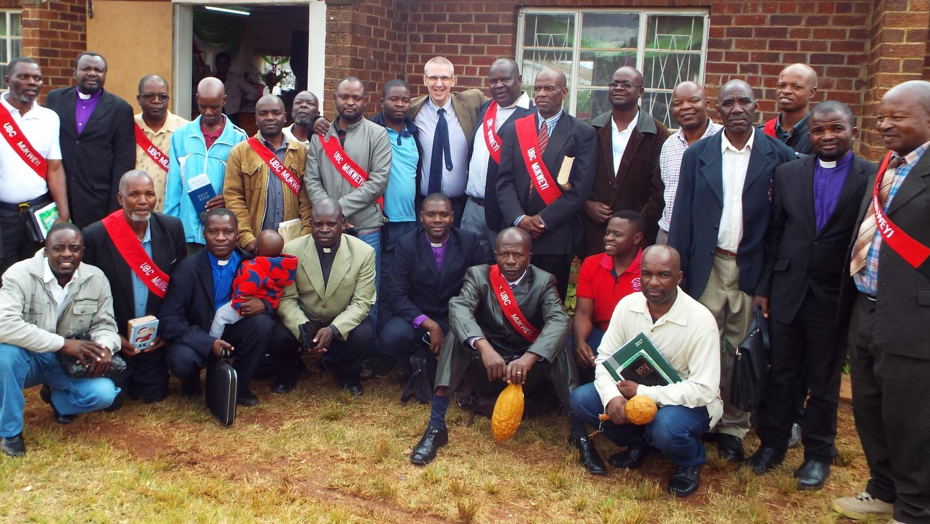


Slide 17


Grow & LEARN
Contact us today for a demonstration of the LEARN system:
www.churchleaderslearn.org
learn@churchleaderslearn.org
www.churchleaderslearn.org

